Slide 1
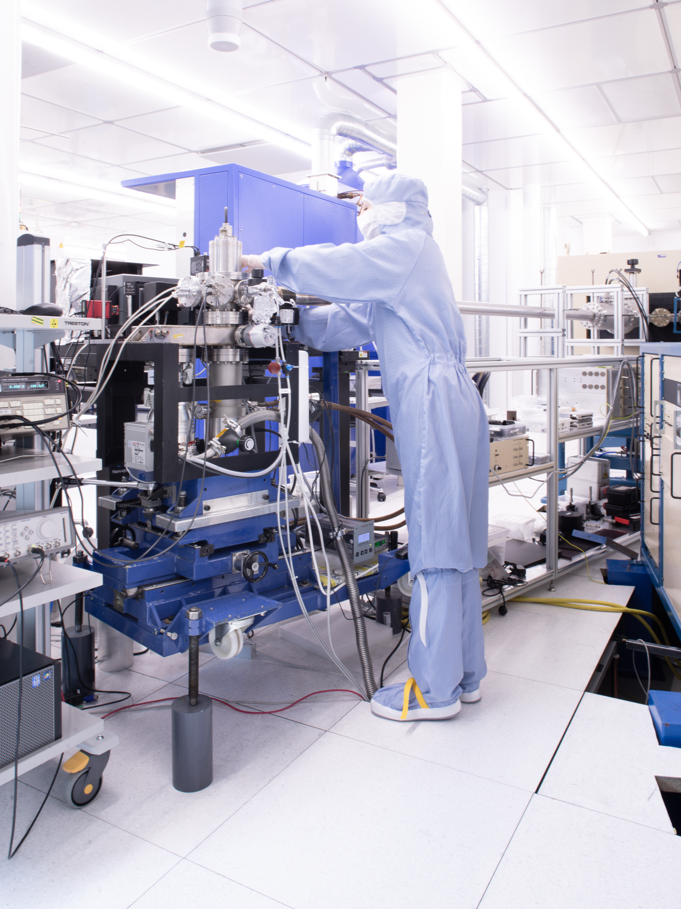

Where are we going? Quantum technology for future applications

Slide 2
1st and 2nd quantum revolution
Overview of quantum technologies
Status and opportunities

Slide 3
1st and 2nd quantum revolution
Overview of quantum technologies
Status and opportunities

Slide 4

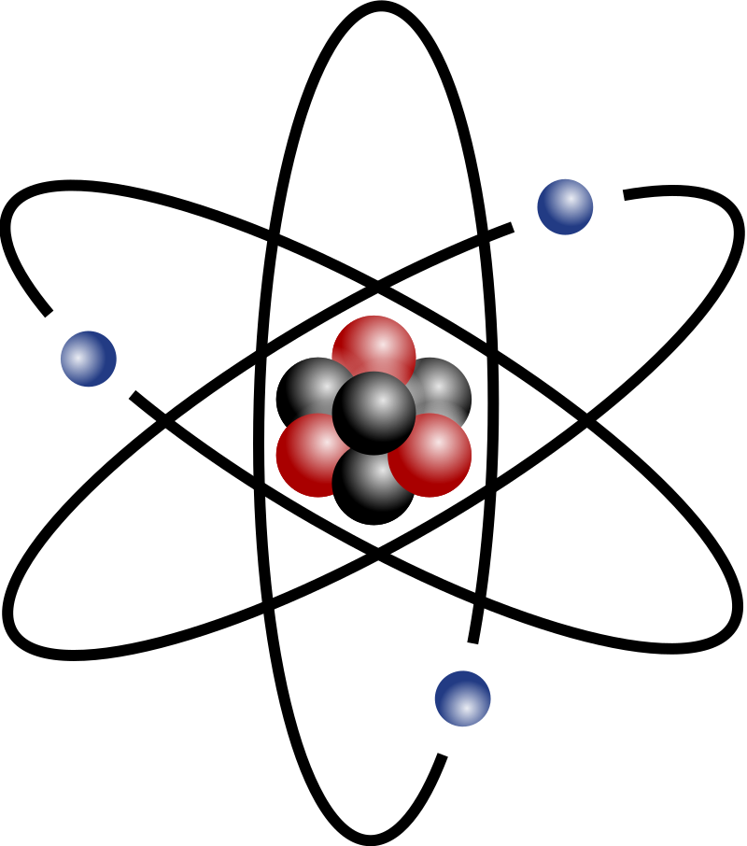
From classical to quantum physics
Kilde: Wikipedia

Slide 5

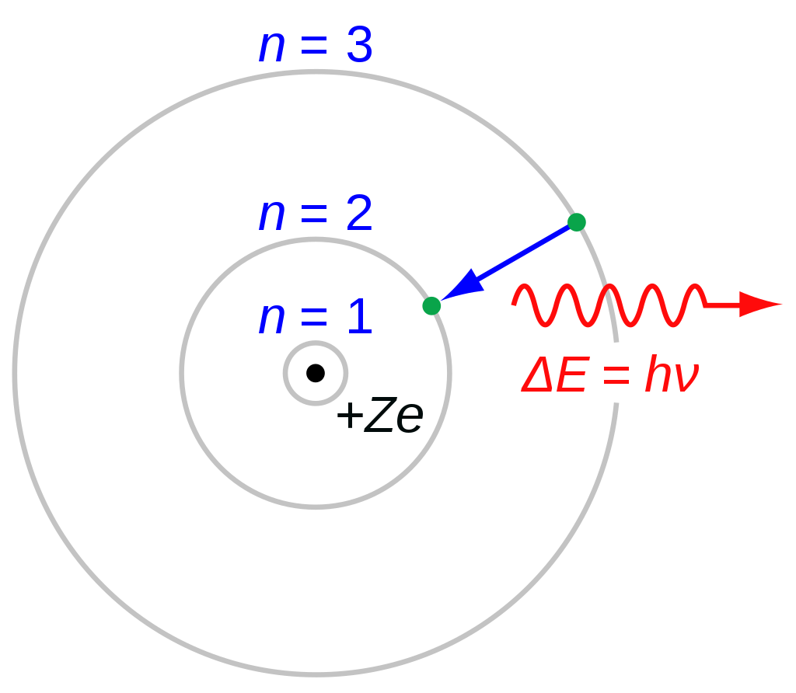

The 1st quantum revolution: Quantum physics experiments
Max Planck, Albert Einstein, Arthur Compton
Niels Bohr
Louis de Broglie
Light can behave like particles
Photons have momentum
Quantum systems have discrete (quantized) energy levels
Particle-wave duality
Particles can exhibit wave-like properties
https://en.wikipedia.org/wiki/Bohr_model#/media/File:Bohr_atom_model.svg
By Roger McLassus, CC BY-SA 3.0, https://commons.wikimedia.org/w/index.php?curid=513043

Slide 6

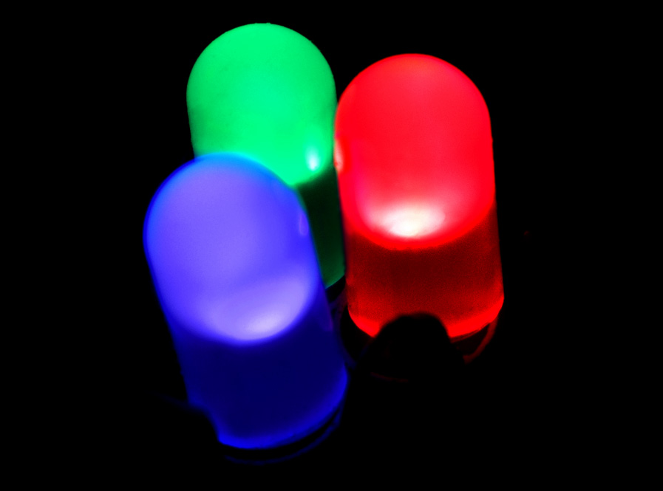
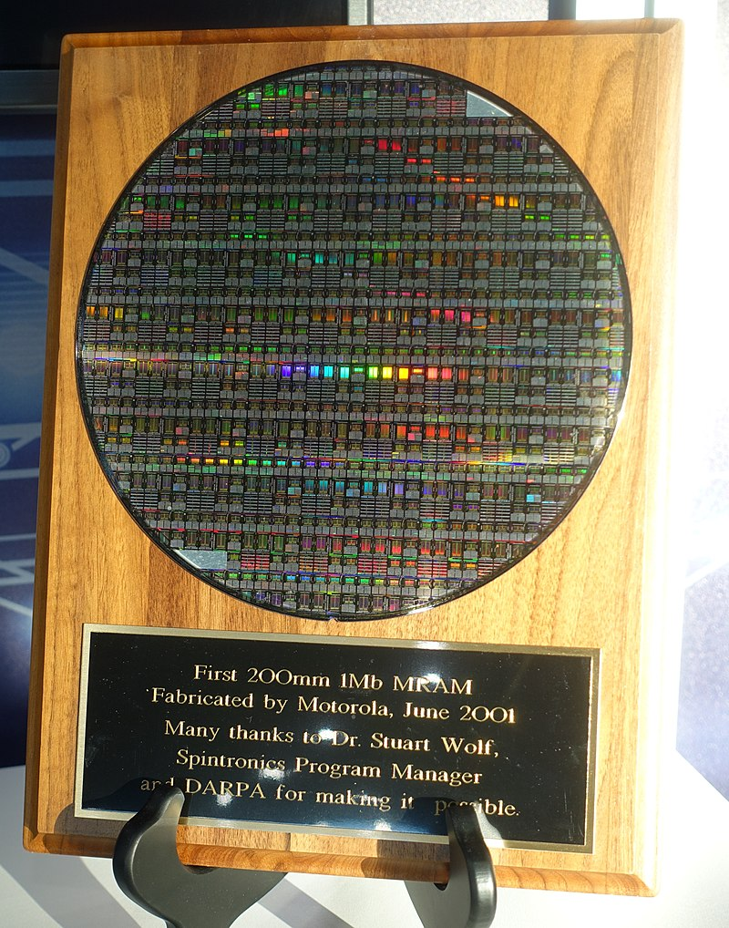

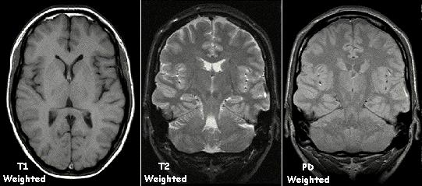
Quantum revolution 1.5: Macroscopic quantum properties
https://en.wikipedia.org/wiki/Magnetoresistive_RAM#/media/File:200mm_1_Mb_MRAM_-_D60_Symposium_-_Defense_Advanced_Research_Projects_Agency_-_DSC05568.jpg
By KieranMaher at English Wikibooks https://commons.wikimedia.org/w/index.php?curid=12766438
https://commons.wikimedia.org/wiki/File:RBG-LED.jpg

Slide 7
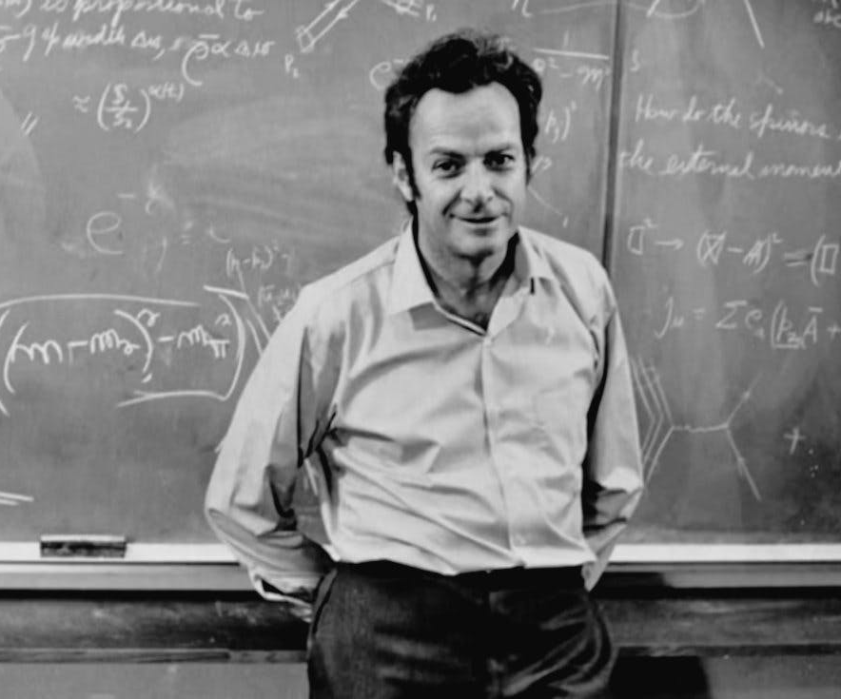
“nature isn't classical, dammit, and if you want to make a simulation of nature, you'd better make it quantum mechanical.”
“nature isn't classical, dammit, and if you want to make a simulation of nature, you'd better make it quantum mechanical.”
Richard Feynman
Richard Feynman, 1981
Quantum technology exploits the unique and exotic properties of quantum mechanics
Superposition
Quantum entanglement
Tunneling

Slide 8

The 2nd quantum revolution: Direct control over quantum systems
1. Computing
2. Sensing
3. Communication
Information processing
Solve tasks not possible with classical computing
Nanoscale spatial resolution
Fast response
Transmit information
Quantum security

Slide 9

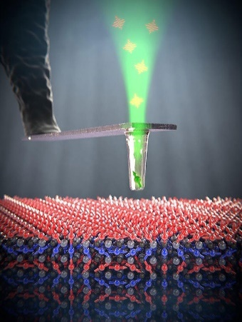
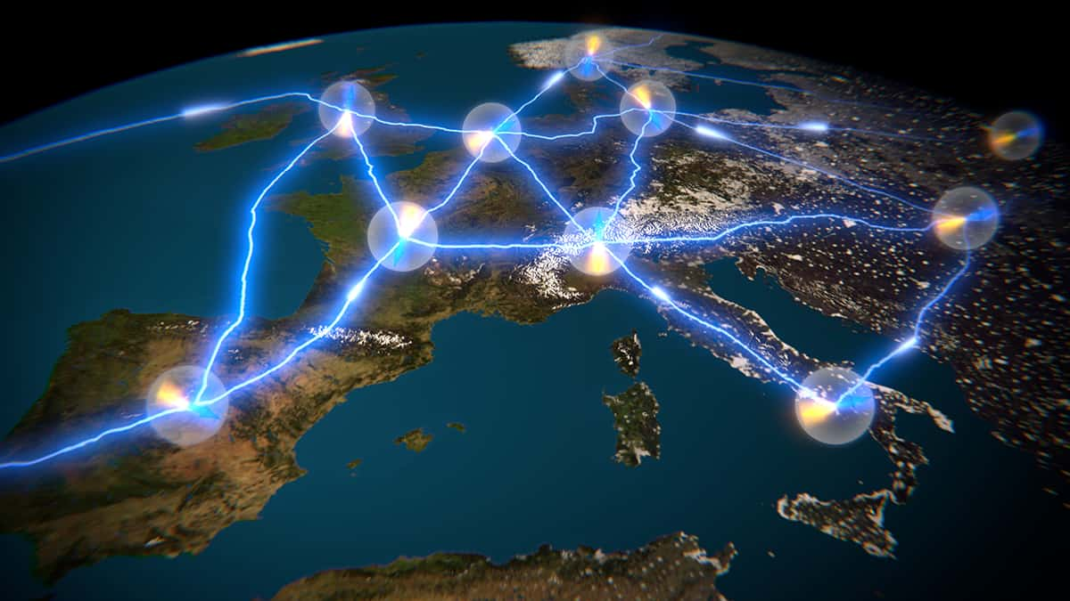

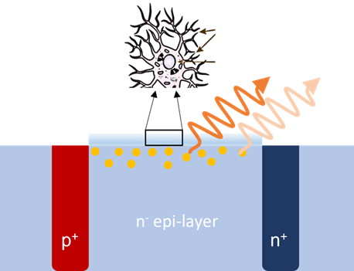



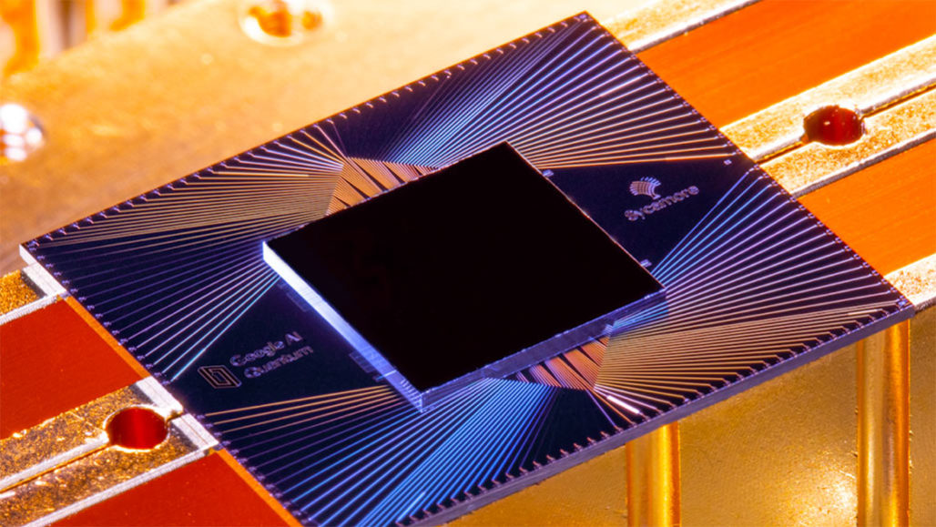
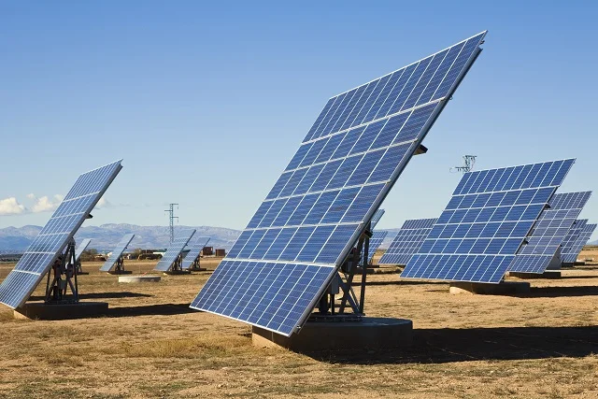
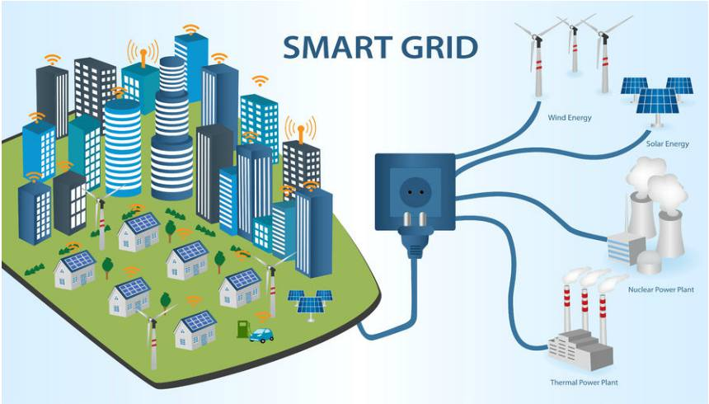
Quantum technology promises new opportunities
Extreme conditions
Quantum commu-nication
Quantum computing
Quantum sensing
Nanoscale
Quantum internet
Quantum cryptography
Better control systems
Signals in cells
Secure communication based on laws of quantum physics
Model finance market
Energy efficient computation
Model weather, climate
Find new drugs and materials for green transition
Better logistics
Optimized energy consumption

Slide 10
1st and 2nd quantum revolution
Overview of quantum technologies
Status and opportunities

Slide 11
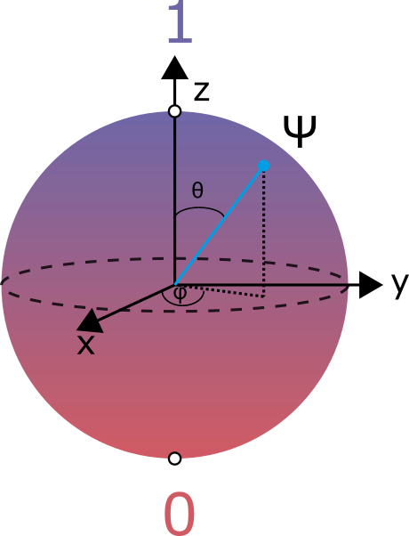
Quantum bits: the building block of quantum technology
Qubit guidelines:
Stable, two-level quantum system
Communication path
Scalable
Energy efficient

Slide 12
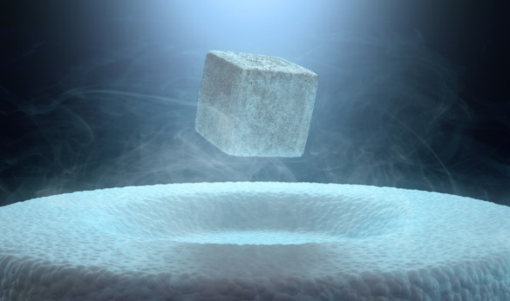
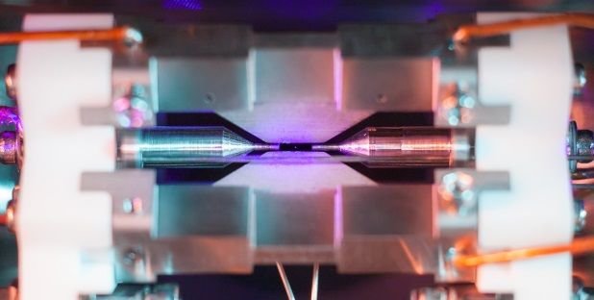

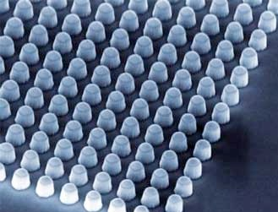
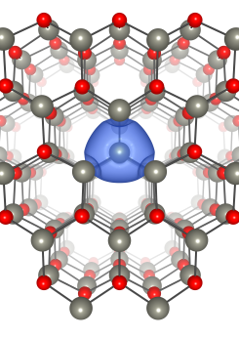
Choice of material platform depends on application
Superconductors
Trapped ions
Optical gratings
Quantum dots
Defects in semiconductors
…
Superconductors
Trapped ions
www2.physics.ox.ac.uk
Optical gratings
Quantum dots
Semiconductor point defects

Slide 13
1. Gate model for quantum computing
Logic gates
Quantum logic gates
Classical circuits based on logic gates
Gates perform logic operations
Rules for answering YES/NO questions
Input is 1 and 0 from transistors/bits
Most popular architecture for QC
Inspired by classical logic gates
Manipulate qubits by gate operations
Quantum circuits are formed by qubits and quantum gates
Example: NOT (inverter)
A | Output
0 | 1
1 | 0
A
Output

Slide 14
Quantum gate operations
Represent qubits as a vector along a Bloch-sphere
Quantum gates can operate on one, two or more qubits
We represent quantum gates by unitary matrices (U*U=I)
1-qubit gates are 2 × 2 matrices
2-qubit gates have 16 matrix elements, etc.
In practice; e.g. pulse of electromagnetic field

Slide 15
One-qubit quantum gates
X gate
Controlled NOT (CNOT)
Quantum NOT
Performs bit flip (0-to-1 and 1-to-0)
CNOT can generate a maximally entangled state between two qubits
Hadamard gate
Quantum analog to one-qubit Fourier transform
Transforms a basis state (0 or 1) to a superposition of states
1
B
A
0
Notes:
Vi så en klassisk NOT, har også en kvante-analog

Slide 16
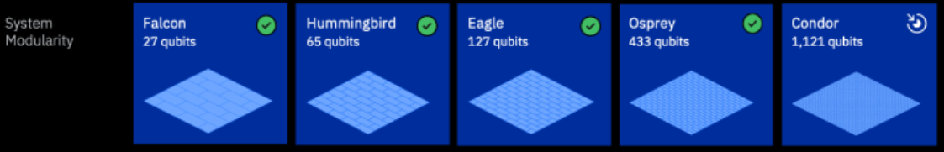
Satus for quantum computing
Where are we now?
Noisy intermediate-scale quantum (NISQ)
Superconducting qubits
Quantum advantage is debatable
Ideal time to learn!
Credit: Google
https://www.nature.com/articles/s41586-019-1666-5
https://www.ibm.com/quantum/roadmap

Slide 17

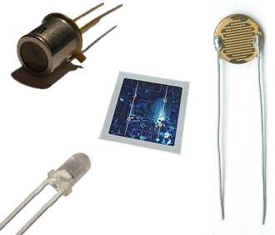

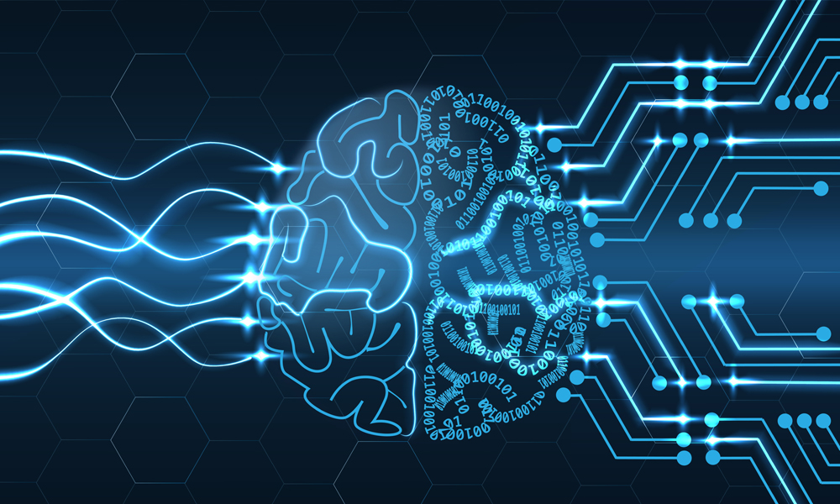
2. Sensors are the foundation of the digital and green shifts
Better control systems
Improved safety
Kilde: Wikipedia
Input to AI
Optimized energy consumption
https://iot.eetimes.com/the-power-and-potential-of-applying-artificial-intelligence-to-sensor-generated-data/​

Slide 18
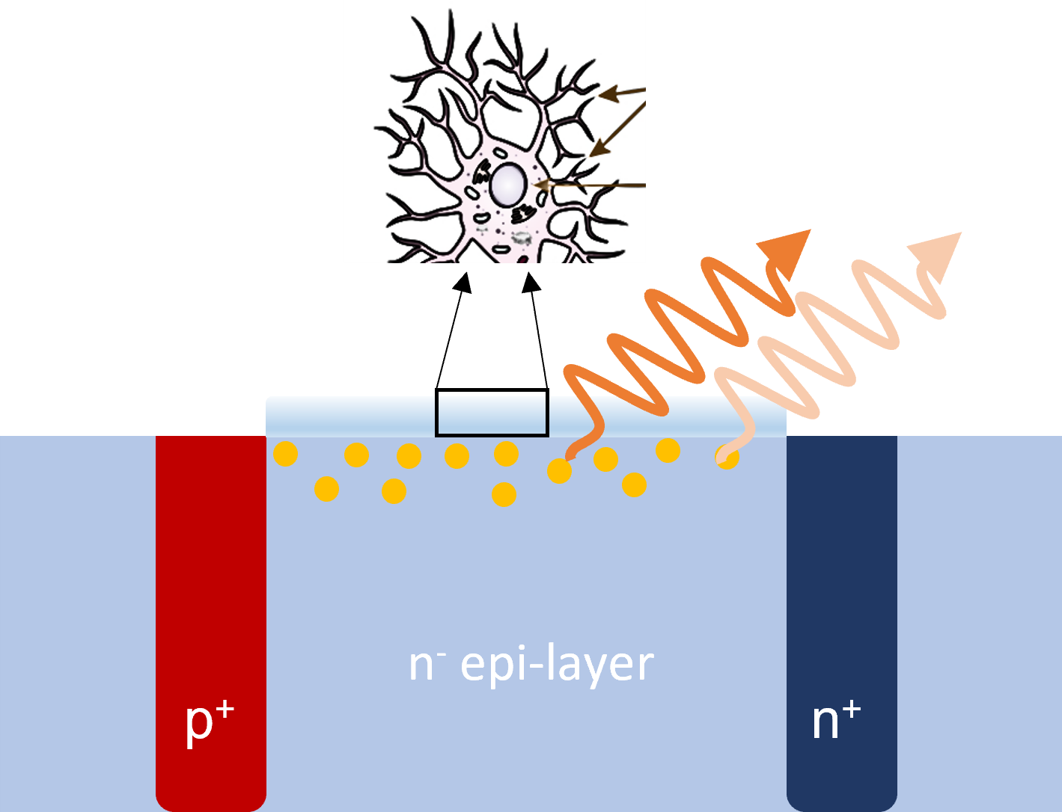
Need for quantum sensors
Limitations of today's technology
Next generation: Quantum sensors
Limitation in detection
Spatial resolution
Sensitivity
Extreme conditions
Limitation in operation
Speed
Extreme conditions
Nanoscale spatial resolution, fast detection and extreme conditions possible
Sensitivity beyond classical limit

Slide 19
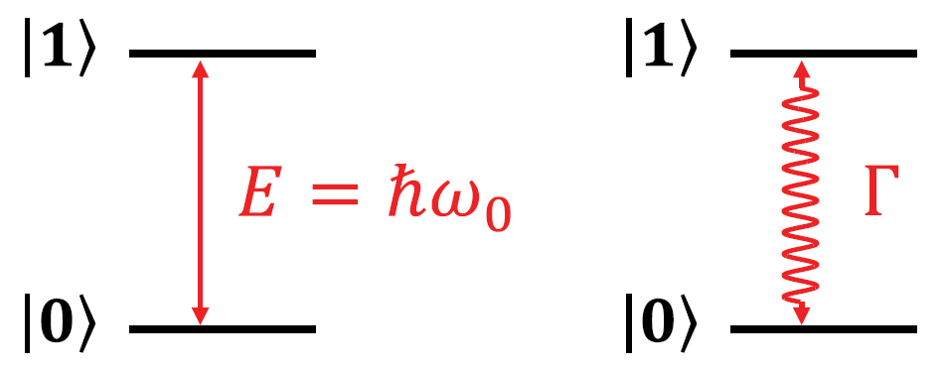
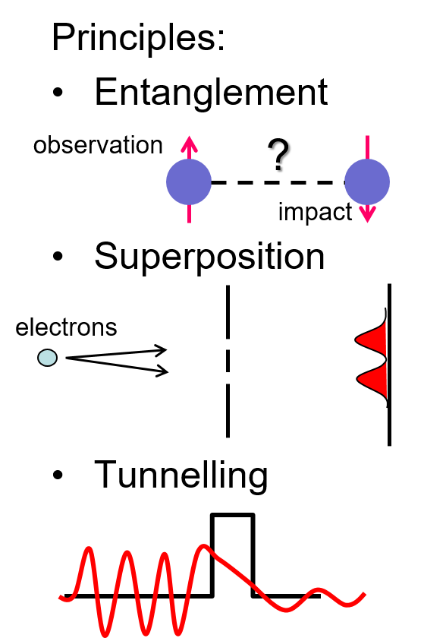
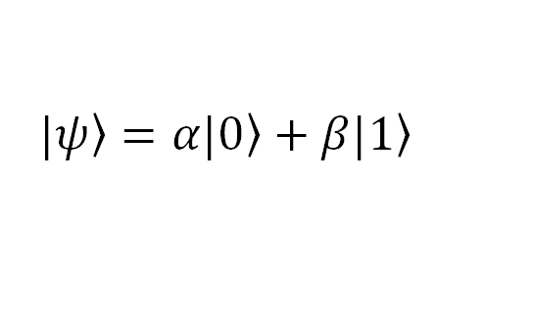
What is quantum sensing ?
Definitions:
Use of quantum system with quantized energy levels to measure a physical quantity
Use of quantum coherence (i.e., wavelike spatial or temporal superposition states) to measure a physical quantity.
Use of quantum entanglement to improve the sensitivity or precision of a measurement, beyond what is possible classically
$$\left.|ψ\right\rangle =α\left.|0\right\rangle +β\left.|1\right\rangle$$
Degen et al., Rev. Mod. Phys., Vol. 89, No. 3, (2017)

Slide 20
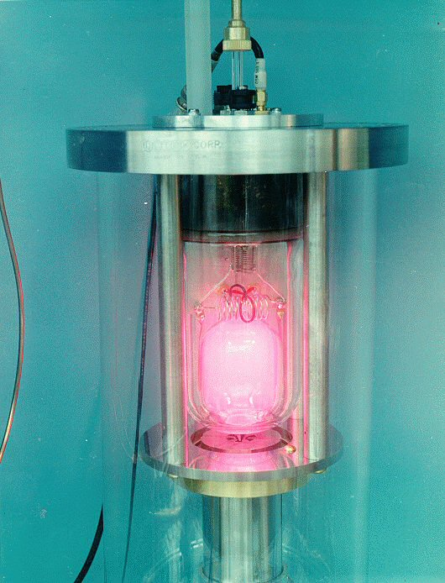
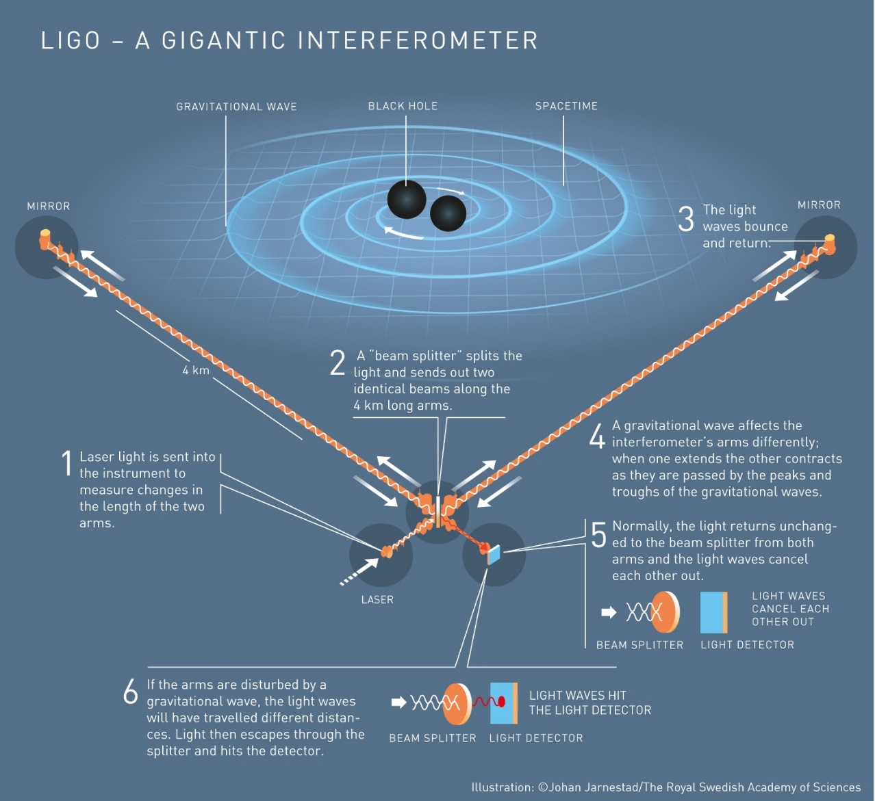
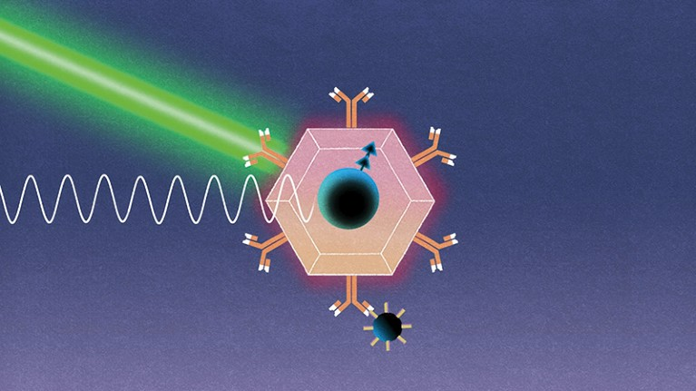
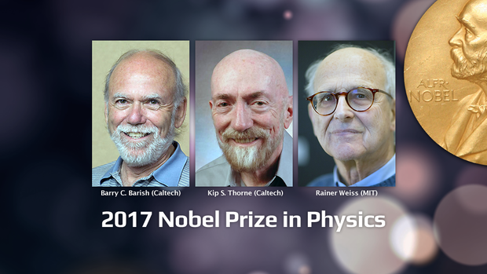
Early examples of quantum sensors
Atomic clock
LIGO: Gravitational wafer
NV-centres in diamond (semiconductor-based) for biological sensing
Kilde: Wikipedia
LIGO collab., Nature Photonics, 7, 613 (2013)
Nature 591, S37 (2021)

Slide 21

3. Quantum communication
Transferring a quantum state from one place to another
Application areas
Provably secure communication
Quantum networks
Optical fiber network
Free space network
Part of quantum computers
Secure quantum internet
https://www.wired.com/sponsored/story/with-quantum-computings-rise-cybersecurity-takes-center-stage/
https://physicsworld.com/a/a-roadmap-for-the-quantum-internet/
Notes:
Quantum communication is the art of transferring a quantum state from one place to another.
quantum communication, where individual or entangled photons are used to transmit data in a provably secure way
Quantum communication involves the generation and use of quantum states and resources for communication protocols. Its main applications are in provably secure communication, long-term secure storage, cloud computing and other cryptography-related tasks, as well as in the future, a secure ‘quantum web’ distributing quantum resources like entanglement, nonlocality, randomness and connecting remote devices and systems https://iopscience.iop.org/article/10.1088/1367-2630/aad1ea/pdf

Slide 22
Transmitting information Flying qubits
Individual or entangled photons are used to transmit data in a provably secure way
Degree of freedom to encode information in
Spatially encoded qubits
Temporal structure
State of polarization
Advantage of photonic polarization qubits
Easily generated and manipulated
Photons interact little with the environment
Notes:
The advantage of using photonic polarization qubits is that they can be easily generated, controlled, and manipulated with rather simple linear optical devices like wave plates. Furthermore, since photons rarely exhibit interaction with the environment they are the best candidates for long-distance free-space transmission as would be required in a future network involving ground-to-space links.
https://link.springer.com/chapter/10.1007/978-3-319-31903-2_18

Slide 23
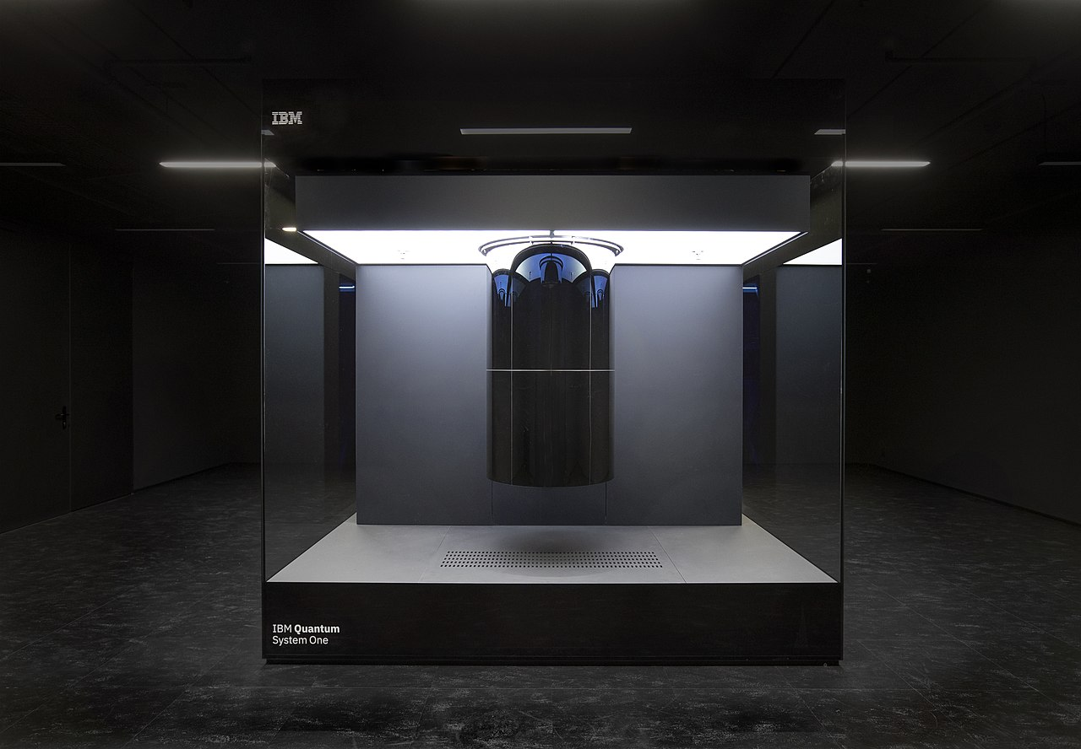
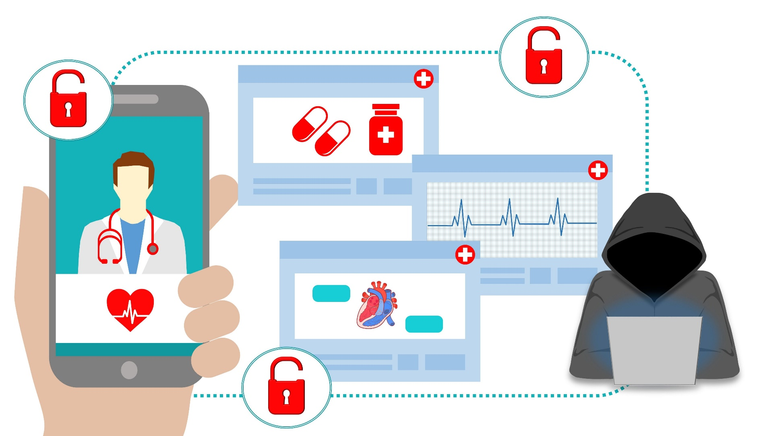
Why quantum communication? Security in the quantum age
https://www.healthcarecompliancepros.com/blog/usa-leads-the-way-with-the-most-expensive-healthcare-data-breaches
IBM Research, https://www.flickr.com/photos/ibm_research_zurich/51248690716/, CC BY 2.0
Notes:
Image of health data , then QC appears
Only images
We have seen multiple examples recently of hacker attacks leaving our personal data vulnerable. This could be passwords, name and phone number, address and so on, but also even more critical data such as health information for hundreds of thousands of citizens.
On the larger scale, governmental secrets are intended to be kept secret for 50-100 years.
If they are exposed earlier, e.g. espionage, drastic consequences
Quantum computers can make this worse. Not topic of today, but, quantum computers can break classical encryption (in theory, when they get large enough and not so noisy).

Slide 24



Security through quantum mechanics Quantum key distribution (QKD)
Encrypted message
Public (classic) channel
Alice
Eve
Bob
Distribution channel for the quantum key
Notes:
One protocol of QKD. There are others, but this is one of the most commonly discussed ones
Takeaway:
If Eve tries to read te qubit states, A and B will know and sen da new key instead
Cannot copy the key for later
Future proof, because does not rely on assumptions for how hard the problem is, only physics
Drawback: Classical channel could be breached. SLOW! Have to check the key each time! There are more efficient schemes
Quantum cryptography, more specifically QKD, promisies in principle unconditional security based on the laws of physics only. NQKD is a remarkable solution to long-term security as, in principle, it offers security for eternity. Unlike conventional cryptography, which allows Eve to store a classical transcript of communications, in QKD, once a quantum transmission has been completed, there is no classical transcript for Eve to store. See Box 1 for background information on secure communication and QKD.
We use this to send the encryption key safely.
Alice sends photons to bob. Information is encoded in polarization state of the photon.
QKD involves sending encrypted data as classical bits over networks, while the keys to decrypt the information are encoded and transmitted in a quantum state using qubits.
https://www.technologyreview.com/2019/02/14/103409/what-is-quantum-communications/
Various approaches, or protocols, have been developed for implementing QKD. A widely used one known as BB84 works like this. Imagine two people, Alice and Bob. Alice wants to send data securely to Bob. To do so, she creates an encryption key in the form of qubits whose polarization states represent the individual bit values of the key.
The qubits can be sent to Bob through a fiber-optic cable. By comparing measurements of the state of a fraction of these qubits—a process known as “key sifting”—Alice and Bob can establish that they hold the same key.
If Eve tried to intercept and measure the data, she would change the qubits, and Alice and Bob would know there Was an eavesdropper.
An important and unique property of quantum key distribution is the ability of the two communicating users to detect the presence of any third party trying to gain knowledge of the key. This results from a fundamental aspect of quantum mechanics: the process of measuring a quantum system in general disturbs the system. A third party trying to eavesdrop on the key must in some way measure it, thus introducing detectable anomalies.
We’re already starting to see more QKD networks emerge. The longest is in China, which boasts a 2,032-kilometer (1,263-mile) ground link between Beijing and Shanghai. Banks and other financial companies are already using it to transmit data. In the US, a startup called Quantum Xchange has struck a deal giving it access to 500 miles (805 kilometers) of fiber-optic cable running along the East Coast to create a QKD network. The initial leg will link Manhattan with New Jersey, where many banks have large data centers.
Security: Quantum communication allows for secure transmission of information through the use of quantum key distribution (QKD), which enables two parties to generate a shared secret key by exchanging quantum information. Since the act of measuring a quantum state changes it irreversibly, any attempt to eavesdrop on the transmission will be detected by the communicating parties. This makes it virtually impossible for an attacker to intercept the transmission without being detected, ensuring the confidentiality and integrity of the transmitted information.
Should be called quantum key expansion?
Overall, the advantages of quantum communication make it an attractive technology for applications that require secure and efficient communication over long distances, such as government, military, and financial institutions.
QKD involves sending encrypted data as classical bits over networks, while the keys to decrypt the information are encoded and transmitted in a quantum state using qubits.
https://www.technologyreview.com/2019/02/14/103409/what-is-quantum-communications/
Although QKD is relatively secure, it would be even safer if it could count on quantum repeaters.

Slide 25
1st and 2nd quantum revolution
Overview of quantum technologies
Status and opportunities

Slide 26
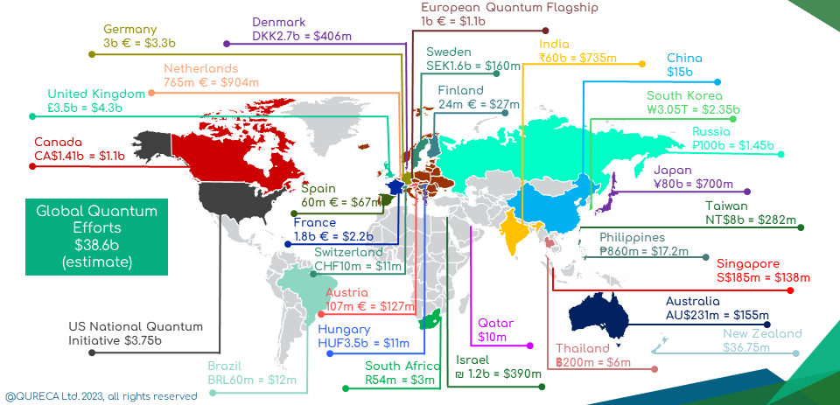
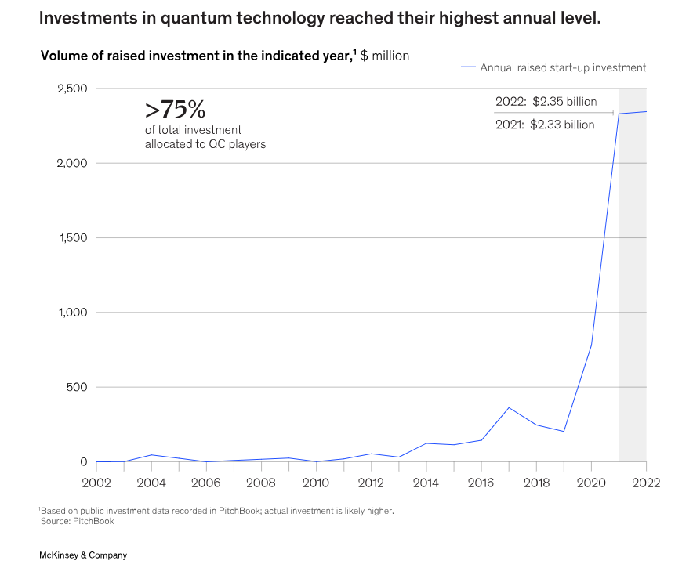
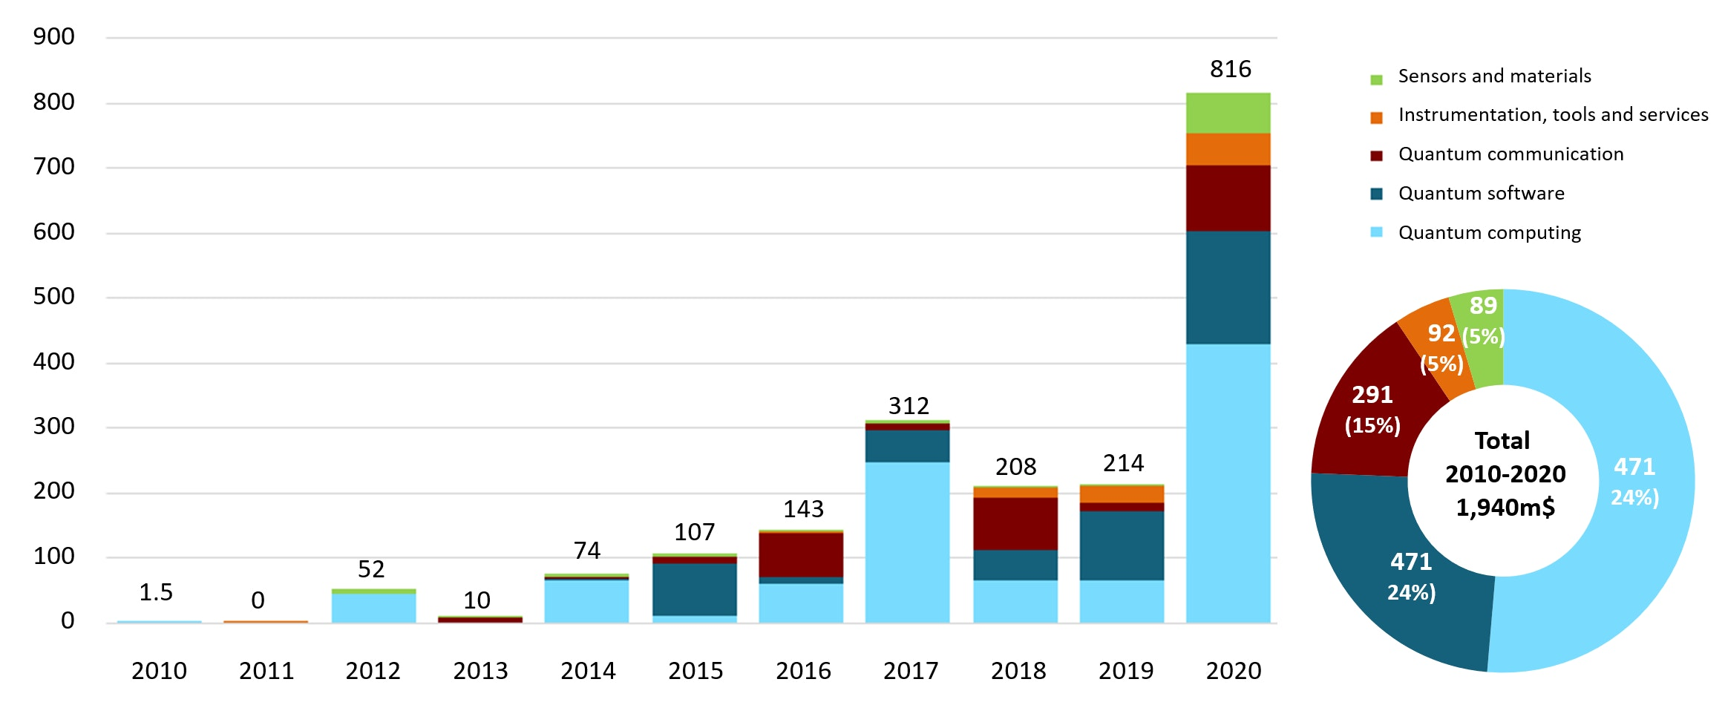
Quantum technology is a major theme in research and technology development
Quantum sensors and materials are being developed now
McKinsey estimates investment in QT > 100 billion USD by 2040
https://www.aspi.org.au/report/critical-technology-tracker

Slide 27
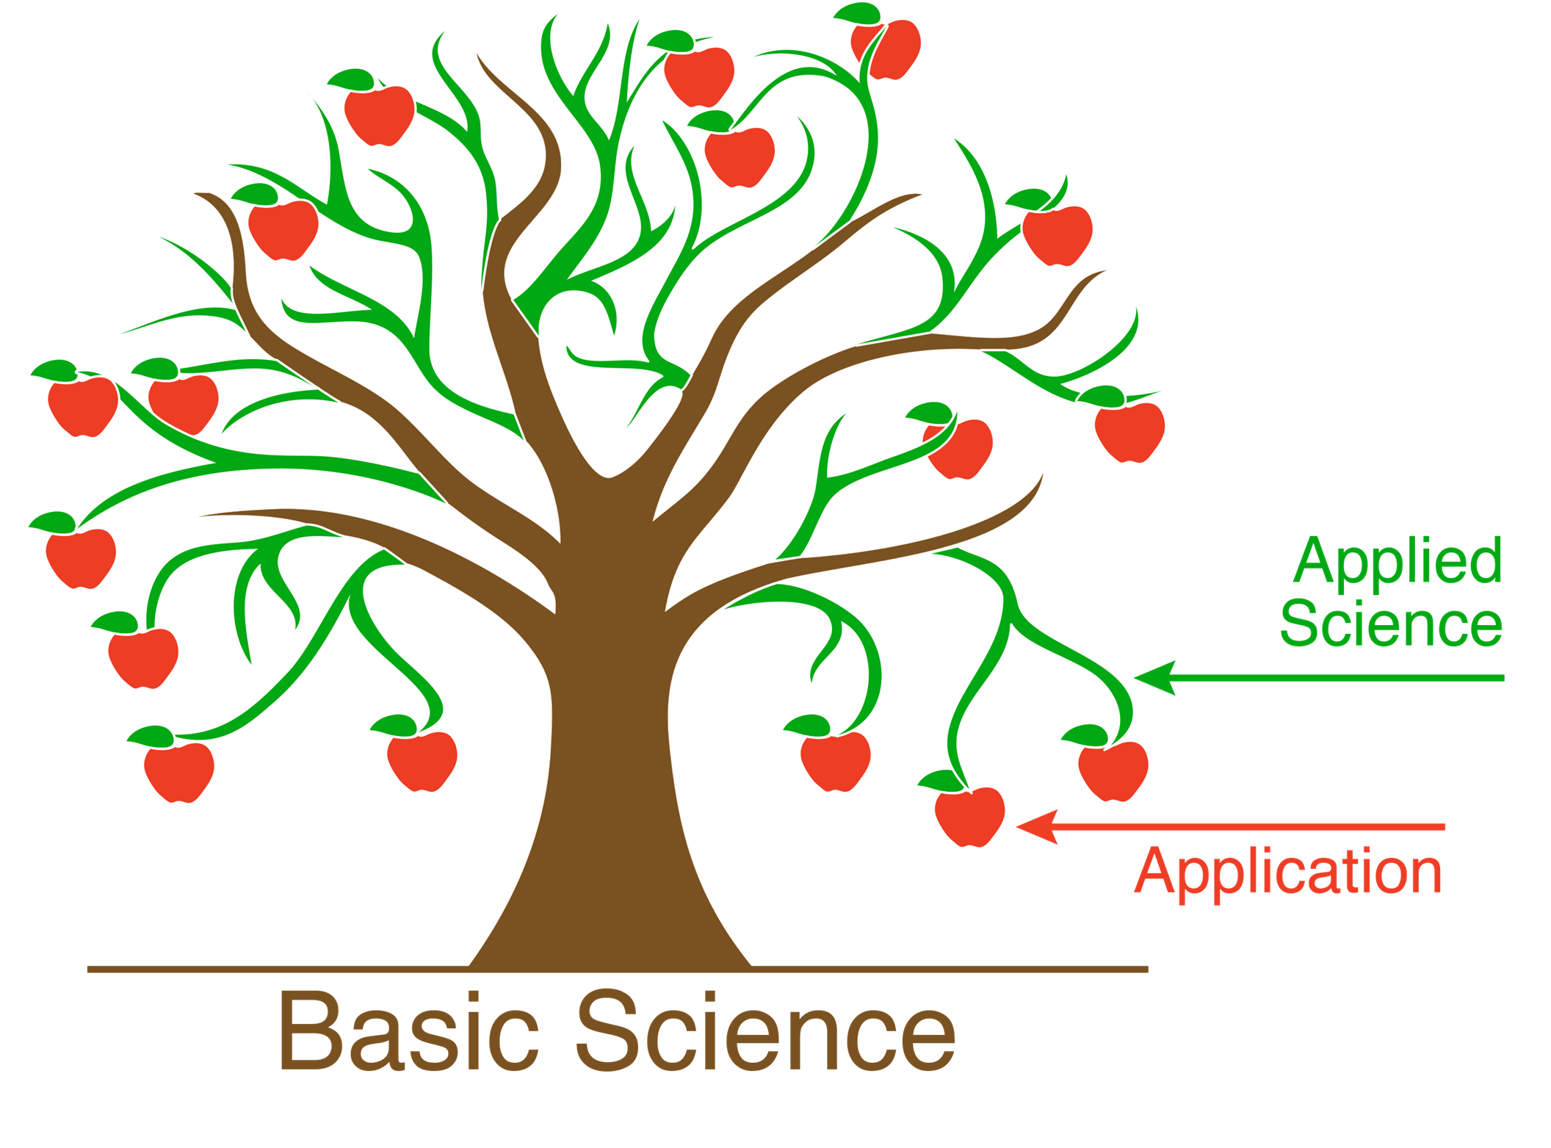
UiO is investnig in QT
QT for future development
Education
Infrastructure
Research

Slide 28
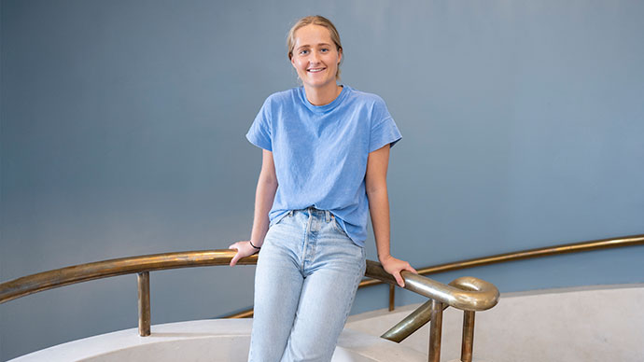
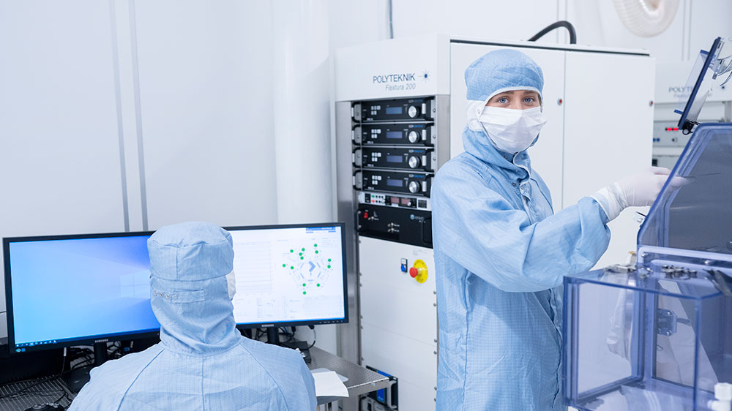


Education
Ny studieretning i kvanteteknologi (BSc)
Starter høsten 2024
Gir bred bakgrunn over hele feltet
Dette er det første BSc-programmet i Norge, og andre i Norden, med en slik mulighet
Nye studieretninger på MSc-nivå ved FI
Studieretning for kvanteteknologi og maskinlæring innen beregningsorientert vitenskap
Studieretning i kvanteteknologi innen fysikk
PhD (forskerutdanning)
Quantum literate workforce

Slide 29
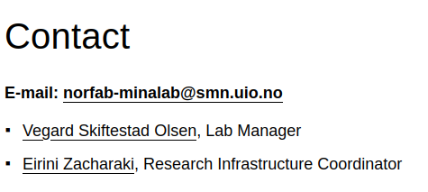
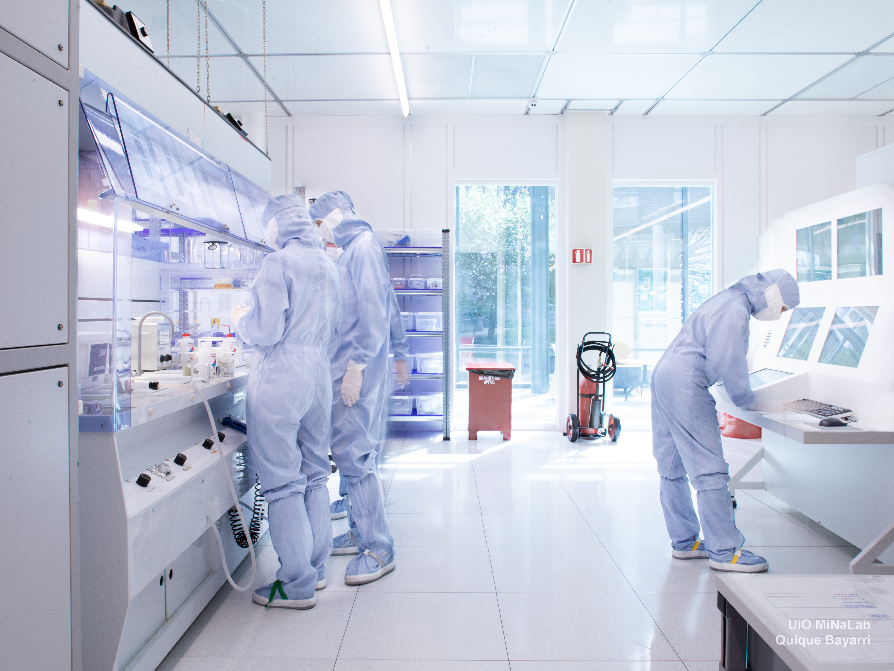
UiO MiNaLab
Infrastructure
QT is an experimental field
QT is a main strategic area in NorFab
Norway needs competence building in practical QT
NorFab and UiO-MiNaLab provide open-access test arena for QT

Slide 30
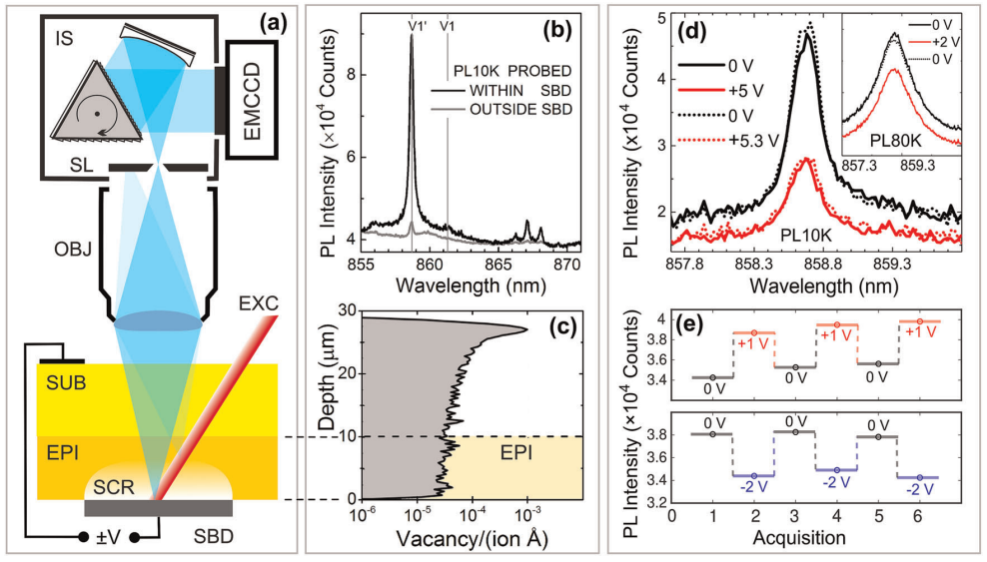
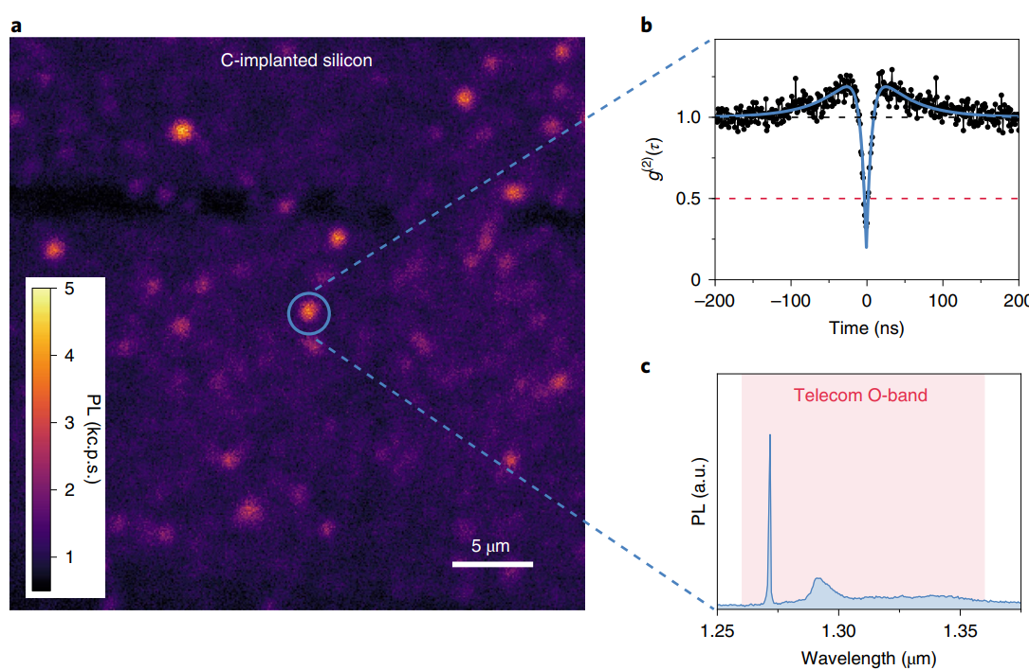
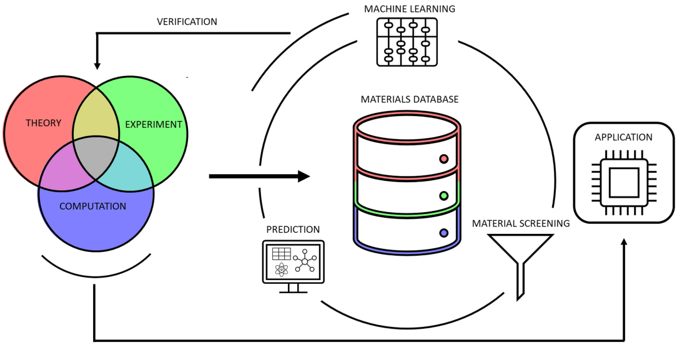
Research
UiO has extensive theoretical, computational and experimental quantum science and technology
Semiconductors for sustainable QT
Quantum sensors will be strategically important for Norway
npj Quantum Information, vol. 5, 111 (2019).
Nature Electronics, vol. 3, 738 (2020).
Collaboration between research, start-ups, industry and public sector is needed
npj Comp Mat, vol. 8, 207 (2022).

Slide 31
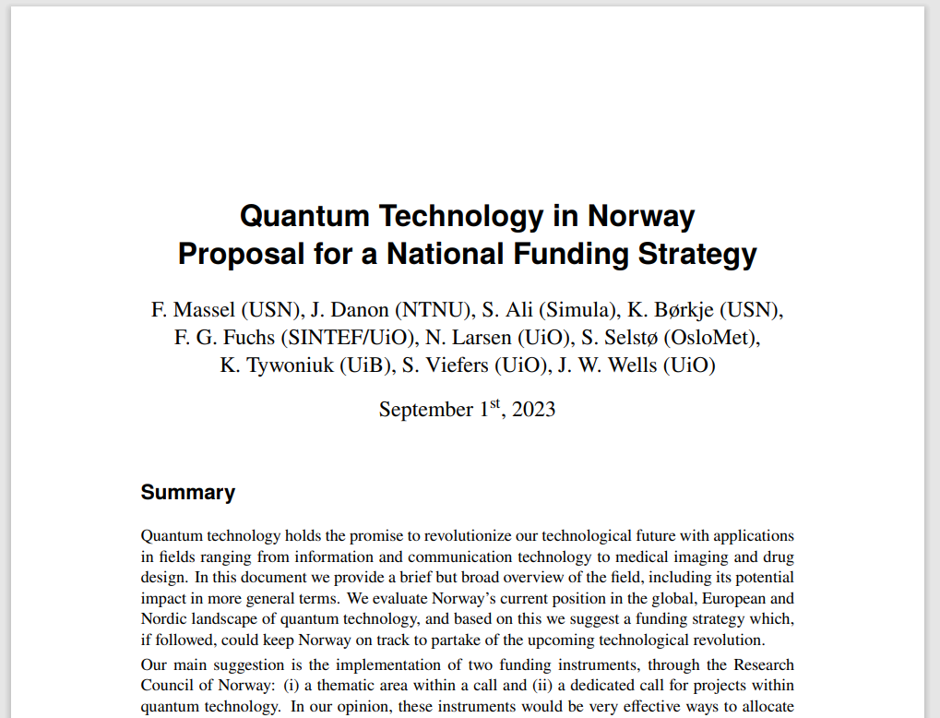



QT for future development
White paper: Quantum Technology in Norway – Proposal for a National Funding Strategy
Self-published on https://www.quantumnorway.no/
Education
Infrastructure
Research

